Slide 1

Front Range Action Sports
Leading the way in summer recreation product development

Slide 2
Mission
Our mission is to provide customers with an unparalleled collection of sporting goods and outdoor recreation merchandise. We strive to do so while ensuring that our clients receive the best customer service possible so that they can enjoy their recreational activities to the fullest.

Slide 3
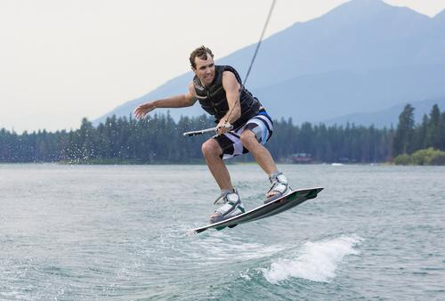
Summer Product Improvement Objective
Continue to improve the safety and performance of our water sports line in order to maintain our position as the leader in water sport product development.

Slide 4
Research and Development
Boating Industry
Personal Watercraft
Luxury Power Boats
Boating Accessories
Life Vest Safety
Anchor Systems
Recreation
Tubes
Wakeboards
Notes:
These are areas in which we are focusing product development in the next five years.

Slide 5
Wakeboard Development
Boards
Bindings
New technology in fin development
Two additional rocker designs
Stability and flexibility
Improved comfort

Slide 6

Popular Lake Recreation Products
Wakeboards
Bindings
Life vests
Tubes
Loungers

Slide 7
Summer Product Line Sales Projects in Millions

Slide 8

Watersports product sales continue to increase due to the popularity of destinations such as Lake Powell in Utah

Slide 9

Research and Development Plan
A Summer Sports Leader

Slide 10
Front Range Action Sports

